Slide 1
Bengkel GREEN OFFICE BERSAMA PEGAWAI Kelestarian

Slide 6
Research
CEMAC
REDAC
CGSS
etc
Governance and Practice
Policy
and Paractices
Teaching
MBA in SD
MDP
WUS
Outreach
BJIM
Unit peneraju sosial inovasi dan pemindahan ilmu

Slide 8
NO OPTION BUT TO Continue to FLY

Slide 9
So far what we have planned and done
Improve process – portal, website and etc
Policy – new policy to be introduced
Practice – Green office
Reporting – web site under construction
Template for sustainability reporting – in discussion

Slide 10
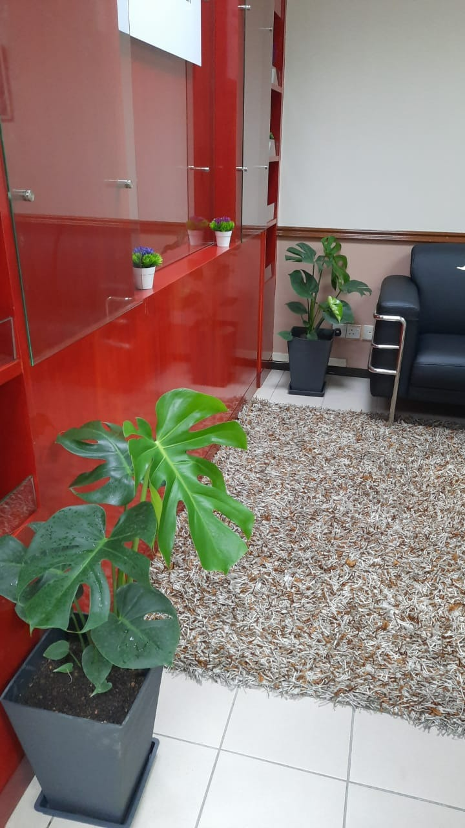
Green office
Mengamalkan 5 kriteria berikut:
Perolehan Hijau
Pengurusan Sisa
Kecekapan Sumber
Kesihatan dan
Keselamatan
Penglibatan Staf &
Komuniti

Slide 11
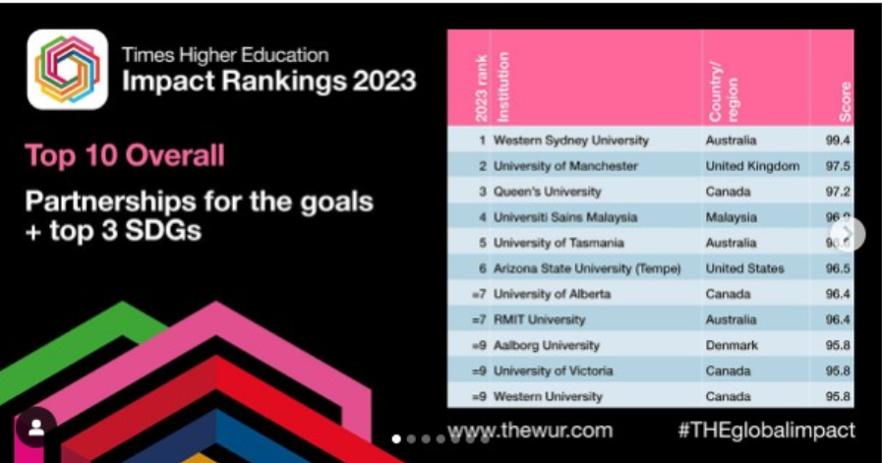

Slide 12
Few key words:
Evidences
FB
Mapping
SDG, Indicators & PTJ
Program/Activity produce results
Sistem
Pegawai kelestarian
Training and Commitment
Website
Dasar
Facilitation (e.g Grant BJIM)

Slide 13
Peranan Pegawai kelestarian
Representative
Promoter
Planner
Implementor
Advocator
Partner
Recycling Bin & Plastic
Akan keluarkan surat dan kempen

Slide 14
We start with
Recycling Bin & Plastic
Akan keluarkan surat dan kempen

